Slide 1


Changing Fashion Trends with Time
Anuj Tanwar

Slide 2
Changing Fashion Trends with Time
Fashion has always been a changing and evolving field.
Fashion industry is going through huge innovations with changing Technology.
Fashion is observed in anything a person has or does. Ranging from clothes, shoes, watches, TVs to cars, food and houses.
Can Data Science help in Changing Fashion?
Data Science and Data-Driven decision making is going to play an important role in changing fashion trends.
Consumer data on trends and brands can be collected and analyzed.
Using that data, trends can be forecasted.

Slide 3
Factors Promoting Change in Fashion
Sustainability
Fashion has been one of the biggest contributor to waste and climate change.
Brands are moving towards more sustainable raw materials and production methods.
Fast fashion was quick and inexpensive is in decline.
Data Driven Fashion
Brands can project and create designs that consumers are more likely to buy by leveraging data
Predictive Analysis can be utilize to project designs
Technology
Technological advancements have enabled brands to use more effective and eco-friendly ways
Simple Styling
Work from home has increased demand for simple and comfortable clothes to wear.
Simplifying fashion is also reducing waste and amount of clothing produced.

Slide 4
5-Different Fashion Research Areas
Usage of synthetic fibers in Clothes
Role of Social media in Fashion Industry
eCommerce in Fashion is changing business model
Environment crisis and changes triggered from it
Impact of Economical changes on fashion

Slide 5
1-Usage of Synthetic Fibers in Clothes
Synthetic Fiber include polyester, nylon, acrylic and spandex.
Some facts about synthetic fibers and clothes made with them:
Per laundry, 9 million plastic microfibers are released
Per household, 6 kg of microplastics is generated per year
Both tap and bottled water contains microfibers
35% of microplastic in oceans comes from laundry
Microfibers comes from carpets, curtains, blankets and other items along with clothes
Microfiber plastics are found in fish, chicken, sea salt, beer, and honey

Slide 6
1-Usage of Synthetic Fibers in Clothes
Conclusion
Production of Synthetic fibers have been on increase since 1950s and it is concerning.

Slide 7
2-Role of Social media in Fashion Industry
Social media has led consumers to adopt and move on from fashion trends quicker than before.
Though it has created new challenges for brands and they must keep up with the forecasts, social media has also enabled brands to connect with customers in new ways.
Targeted ads, Cultivating brand images and increasing brand awareness are some of the benefits brands have with social media.
Per Statista (2020), there are 3.78 billion social media users which equates to about 48% of the population.
Facebook accounts for 22% of direct social-to-sale purchases in fashion and beauty.
58% of shoppers use their mobile devices in store to research products, 54% to conduct price checks, and 40% to access or download digital coupons.

Slide 8
2-Role of Social media in Fashion Industry
Social Medial Usage by Generations
Majority of people between 18-64 are using social media, hence, brands use social media platforms to promote their products.
64% of social shoppers turn to message boards or blogs for inspiration before making a fashion-related purchase decision.
27% of fashionistas’ costume jewelry, special occasion, and casual clothing purchases are influenced by Pinterest.
130 million Instagram users tap on shopping posts every month.

Slide 9
2-Role of Social media in Fashion Industry
Mobile-researchers make more purchases than non-mobile researchers, and 78% spent more than $50 on their last apparel purchase
64% of social shoppers turn to message boards or blogs for inspiration before making a fashion-related purchase decision
Conclusion
All the above observations conclude that social media plays an important role in fashion industry and brands must keep up their online competition and utilize social medial to promote their sales.

Slide 10
3-eCommerce in Fashion is changing business model
In 2018, Fashion industry generated revenue of $481 billion. In 2019, that statistic rose higher to $545 billion and is projected to rise further to $713 billion by 2022.
eCommerce sales of accessories and bags grew by 15.6% in 2018 and expected to grow further by 8.7% by 2022.
43% of purchases in fashion are made by targeted advertisements.
77% of people in South Korea made an online fashion purchase in 2019. That is the most of any nation.
Filtering System: Having efficient filtering system is important and contributes to an online shopping. Best example of it is Facebook marketplace which offers customized results and it’s increasing 77% every month. And this is only one of many relevant examples.
Review: 98% of fashion buyers also stated the importance of reviews.

Slide 11
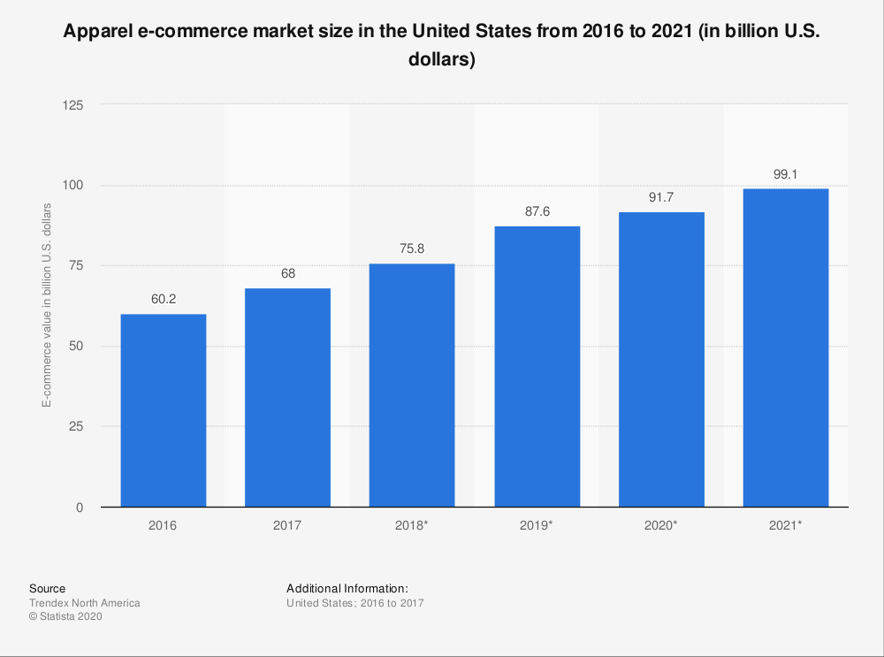
3-eCommerce in Fashion is changing business model
In the US, the ecommerce fashion industry accounted for 29.5% of fashion retail sales in 2020.
The value of the US market is projected to take a sizable chunk out of global predictions, reaching $100 billion by 2021. Attached graph shows the trend between 2016-2021.

Slide 12
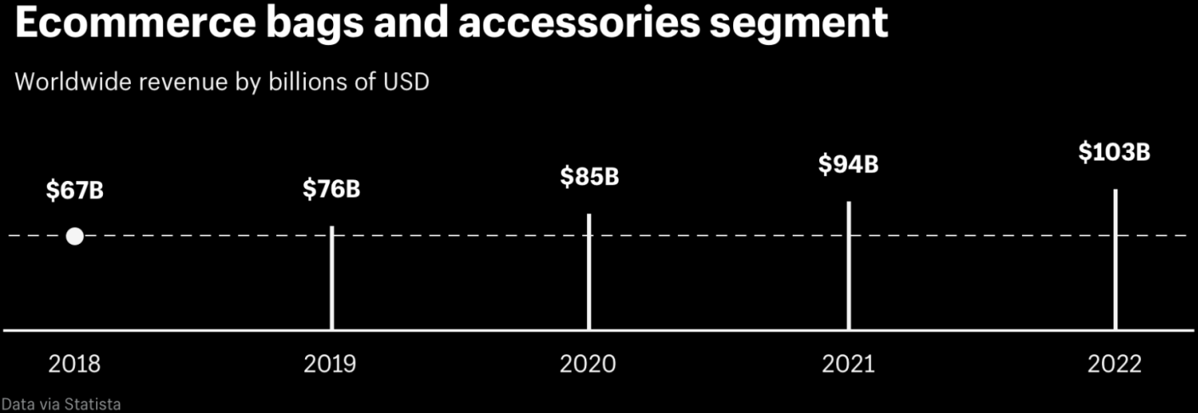
3-eCommerce in Fashion is changing business model
Worldwide sale of bags and accessories has been increasing and is expected to increase to $103 billion in 2022.
Conclusion
All the above observations conclude that Ecommerce has increased the sales in fashion industry and will continue to do so in coming years.

Slide 13
4-Environment crisis and changes triggered from it
The entire lifecycle of one pair of Levi’s® 501® jeans equates to:
33.4 kg CO2 emission equivalent to 69 miles driven by the average US car
3781 liters water consumption equivalent to 3 days worth of one US household’s total water needs
48.9g PO4 emission, The total amount of phosphorous found in 1,700 tomatoes
12 sq. meter of land is occupied per year. Seven people standing with arms outstretched, fingertips touching, would form one side of a square this size.
 | FIBER | FABRIC ASSEMBLY | CUT, SEW, FINISH | SUNDRIES & PACKAGING | TRANSPORT, LOGISTICS, RETAIL | CONSUMER CARE | END OF LIFE | TOTAL
CLIMATE CHANGE (kg CO2-e) | 2.9 | 9 | 2.6 | 1.7 | 3.8 | 12.5 | 0.9 | 33.4
 | 9% | 27% | 8% | 5% | 11% | 37% | 3% | 100%
WATER CONSUMPTION (liters) | 2,565 | 236 | 34 | 77 | 10 | 860 | 0 | 3,781
 | 68% | 6% | 1% | 2% | 0% | 23% | 0% | 100%
EUTROPHICATION (g PO4-e) | 18 | 5.5 | 2.9 | 7.9 | 3.1 | 7.9 | 3.5 | 48.9
 | 37% | 11% | 6% | 16% | 6% | 16% | 7% | 100%
LAND OCCUPATION (m2/year) | 9 | 0.2 | 0 | 0.5 | 0.3 | 1.7 | 0 | 12
 | 78% | 1% | 0% | 4% | 2% | 14% | 0% | 100%
ABIOTIC DEPLETION (mg Sb-e) | 20 | 7.2 | 1.9 | 118.5 | 4.4 | 17.9 | 0.1 | 29.1
 | 12% | 4% | 1% | 70% | 3% | 11% | 0% | 100%

Slide 14
4-Environment crisis and changes triggered from it
750 million people in the world do not have access to drinking water and at the same time fashion industry 1.5 Trillion Liters of water each year
200 Tons of fresh water to dye one ton of fabric
190,000 tons of textile microplastic fibers end up in the oceans every year
85% of human-made debris on the shorelines around the world are microfibers
Only 15% of clothing are recycled or donated
1 Kg of chemicals are needed to produce 1Kg of textiles
23% of all chemicals produced worldwide are used for the textile industry
27% of the weight of a ‘100% natural’ fabric is made of chemicals
23Kg of greenhouse gases are generated for each kilo of fabric produced
70 million oil barrels are used each year to produce polyester
400% more carbon emissions are produced if we wear a garment 5 times instead of 50 times

Slide 15
4-Environment crisis and changes triggered from it
In 2012, Greenpeace named and shamed Levi’s for connections to dangerous water pollution in Mexico in their ‘Toxic Threads’ report.
Levi’s has since pledged to reduce the hazardous chemicals used to dye and treat its clothing.
Levi’s has adopted what they call Water<Less® technique. Levi’s developed more than 20 innovative techniques to use less of water.
Through 2019, 69% of Levi’s bottoms were made Water<Less.
Levi’s went ahead and open-sourced their Water<Less innovation for others in an effort to learn and improve.
There are other brands like Boden, Pact, Organic Basics, Vetta, People Tree, Tentree, Thought Clothing, Two Day Off, Soluna Collective, Back Beat Co., United by Blue, etc which are eco-friendly clothing labels for sustainable fashion.
Conclusion
All above statistics show that fashion industry is causing environmental crisis, however, Levi’s and other brands are pushing to sustainable eco-friendly fashion shows that fashion industry is changing to support environment.

Slide 16
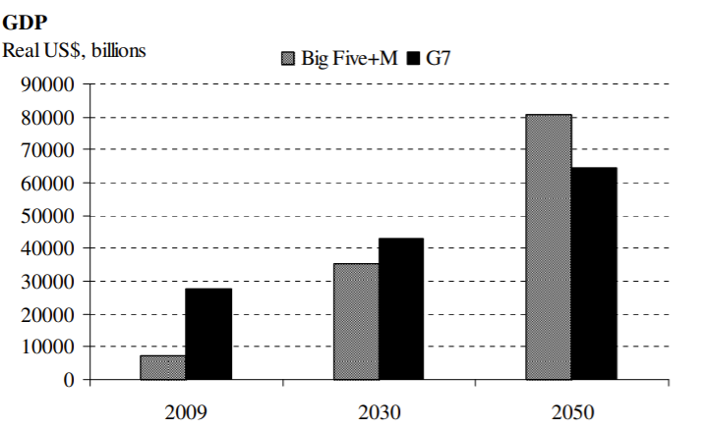
5- Impact of Economical changes on fashion
Clothing production approximately has doubled in the last 15 years, driven by:
Growing middle-class population across the globe
Increased per capita sales in developed economies
World GDP is expected to increase by 400% by 2050 which means even greater demand for clothing
In purchasing power parity(PPP) terms, the shift is even greater (refer the graph)
In China and India alone, GDP is predicted to increase by nearly $60 trillion by 2050, the current size of the world economy
Asia Pacific demand share of apparel market is 38%

Slide 17
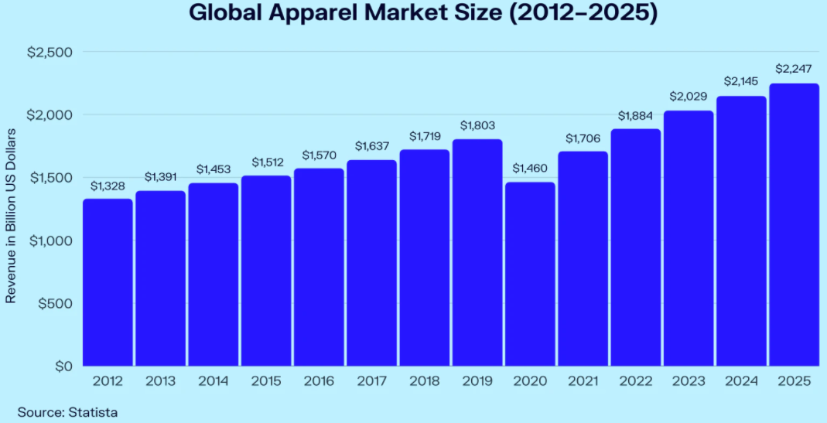
5- Impact of Economical changes on fashion
Conclusion
All above statistics show that with increasing GDP, demand in fashion industry is set to go up.

Slide 18
Conclusion
Fashion Industry has always been changing and innovating. It has also been a contributor to environmental issues.
Demand in Fashion Industry is definitely going up with time and GDP. Data shows there is lot of scope for growth in Fashion, at least till 2050.
As consumer is getting more aware and online negative feedbacks can be devastating for brands, Fashion industry has started adopting eco-friendly practices at the same time trying to keep up with current fashion trends being adopted by majorities.
Trends have also shown that usage of synthetic fiber has increased to concerning level in past and that must change to save the environment.
Business model is also changing from store to online shopping which has its own advantages and disadvantages for brands.
Overall, influenced by various factors, Fashion Industry is going under drastic changes and brands must keep working adapt to changing consumer demands keeping thing environment friendly.

Slide 19
What’s Next?
With changing times, Fashion Industry is facing new challenges. We need to further study in the project how Fashion Industry is impacted and handling below factors:
Explore if Governments are putting any policies and enforcing Fashion Industry to keep their production environment friendly?
Does increasing eCommerce means it is an end to store shopping?
How are factors like Covid affecting Fashion Industries?
How are brands staying Current?

Slide 20
Sources
Usage of synthetic fibers in Clothes:
https://www.oceancleanwash.org/quick-facts/
https://committee.iso.org/files/live/sites/tc61/files/The%20Plastic%20Industry%20Berlin%20Aug%202016%20-%20Copy.pdf
Role of Social media in Fashion Industry:
https://www.oberlo.com/blog/social-media-marketing-statistics
https://www.pewresearch.org/internet/2021/04/07/social-media-use-in-2021/
https://www.vesta-go.com/insights/10-social-media-stats-affecting-the-fashion-industry/
eCommerce Role in Fashion:
https://www.datafeedwatch.com/blog/ecommerce-and-the-fashion-industry
https://www.shopify.com/enterprise/ecommerce-fashion-industry

Slide 21
Sources Continued…
Environment crisis and changes triggered from it:
http://www.levistrauss.com/wp-content/uploads/2015/03/Full-LCA-Results-Deck-FINAL.pdf
https://www.sustainyourstyle.org/old-environmental-impacts
Impact of Economical changes on fashion:
https://carnegieendowment.org/files/World_Order_in_2050.pdf
https://data.oecd.org/gdp/gdp-long-term-forecast.htm
https://www.statista.com/topics/5091/apparel-market-worldwide/#dossierSummary

